Slide 1
ALE3D Simulations of Laser Heating Steel
Zhigang Wu
May 08, 2019

Slide 2
ALE3D Default Units
Length: 1 cm = 0.01 m
Volume: 1 cc = 1 cm³ = 10⁻⁶ m³
Mass: 1 g = 10⁻³ kg
Time: 1 μs = 10⁻⁶ s
Pressure: 1 Mbar = 10¹¹ Pa
Energy: 1 Mbar∙cc = 10⁵ J
Power: 1 Mbar∙cc/μs = 10¹¹ W
Temperature: 1 K
https://wci.llnl.gov/simulation/computer-codes/ale3d

Slide 3
Notes
Turning on axis-symmetry leads to failure—fixed by changing the integrator.
All the 2D simulations were redone with axis-symmetry (x-axis).
Technical points in ALE3D simulations:
The x-axis is always the rotation axis in 2D calculation when the axis-symmetry is turned on.
In present calculations because the energy density is very high near the axis, a mode is erroneously excited using the default integrator.
No physics of laser-plasma interaction is implemented in ALE3D, so the absorption table is constructed using a simple linear rule: extinction parameter is proportional to density. Using available experimental data, or set the parameter based on zone size; e.g., for millimeter zoning, set absorb = 10 cm⁻¹.

Slide 4
ALE3D Parallel Calculation
Partition: multiple of # of cores
Decomp block
-p in command line
4 times faster in parallel

Slide 5
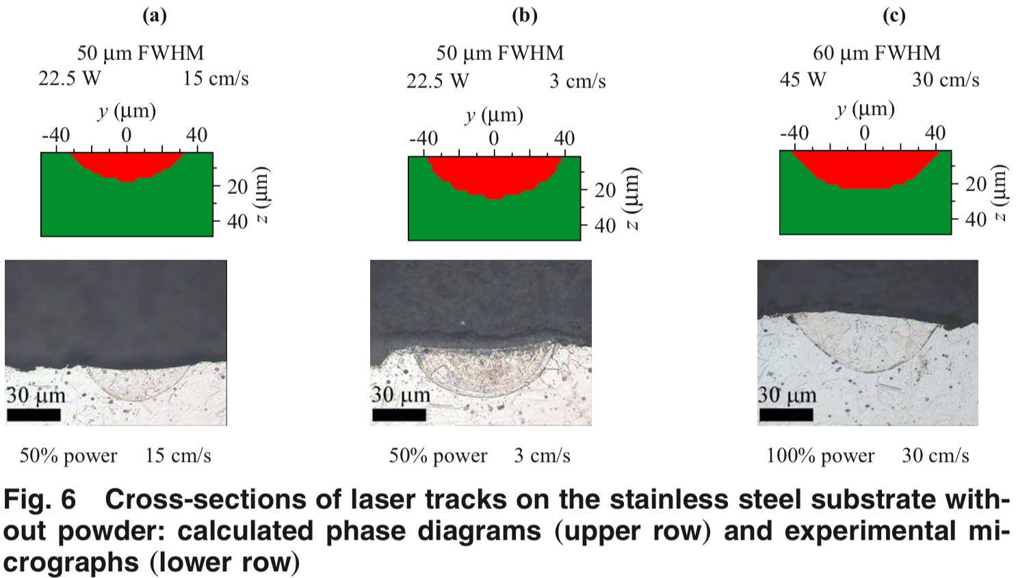
Cross-Section of Laser Heating Steel Substrate (Bulk)
J. Heat Transfer 131, 072101 (2009)

Slide 6
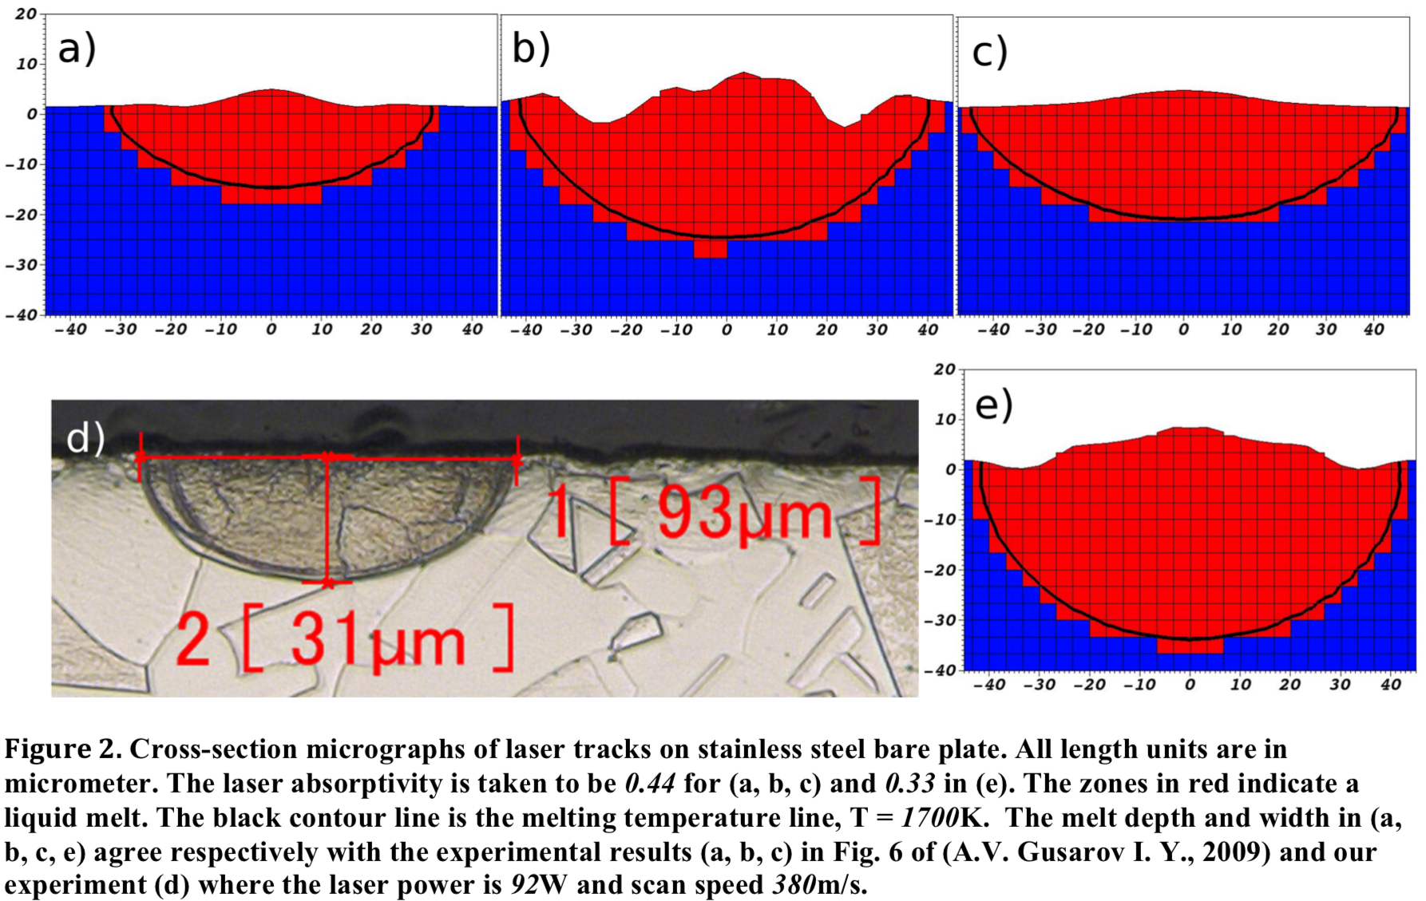
Previous ALE3D Simulations
J. Mater. Proc. Tech. 214, 2627 (2014)

Slide 7
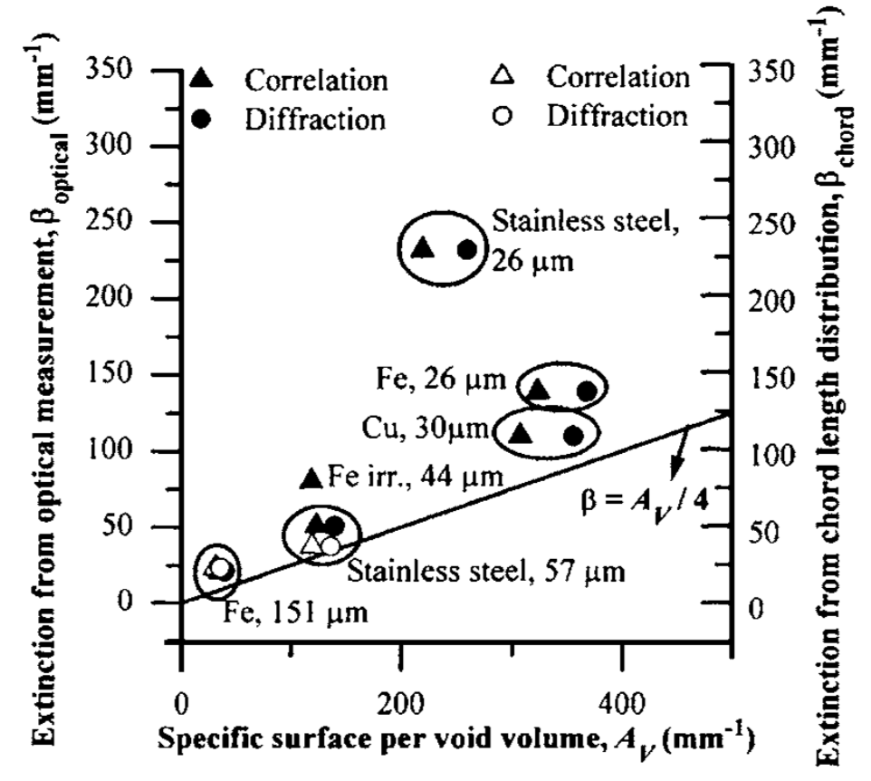
Property Parameters For Steel (Stainless, 316L)
Melting point: 1700 K
Thermal conductivity:
20 W/m∙K = 20×10⁻¹³ Mbar∙cc/cm∙μs∙K
Thermal capacity:
0.5 J/g∙K = 0.5×10⁻⁵ Mbar∙cc/g∙K
Optical properties:
Absorptivity: 44% (reflectivity: 56%)
Extinction coefficient (bulk): 7.53×10⁵ cm⁻¹
Extinction coefficient (d = 57 μm, powder): 500 cm⁻¹
J. Appl. Phys. 98, 013533 (2005)

Slide 8
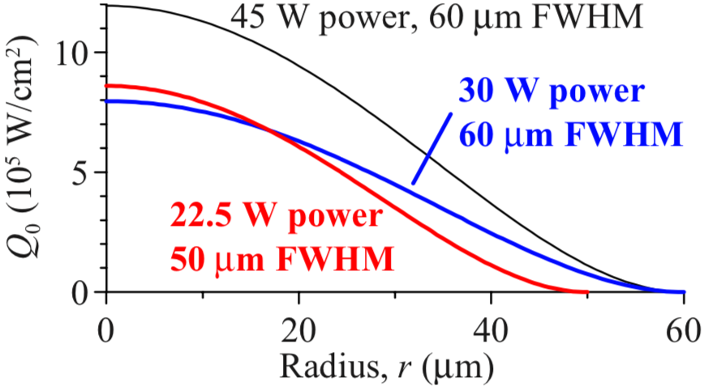
Parameters For Laser
Shape and Size
Circular
Gaussian
k_{G}: Gaussian parameter
k_{G} = 0.6 (default), FWHM = 0.353w (w: width)
at the edge (r = w/2), p = 0.004 p₀

Slide 9
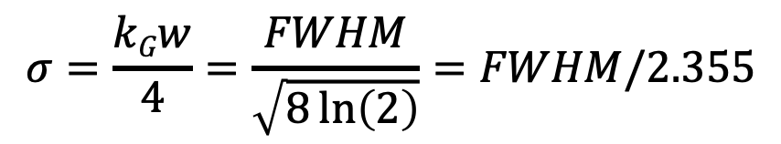
Parameters For Laser
Shape and Size
Circular
Gaussian
FWHM: 50 μm
w: 141.6 μm
FWHM: 60 μm
w: 169.9 μm
Power (P):
22.5 W & 45 W
$$σ=\frac{kGw}{4}=\frac{FWHM}{\sqrt{8\ln\left(2\right)}}=FWHM/2.355$$
P = 22.5 W, FWHM = 50 μm, p₀ = 7.94×10⁵ W/cm²
P = 45.0 W, FWHM = 60 μm, p₀ = 1.10×10⁶ W/cm²

Slide 10
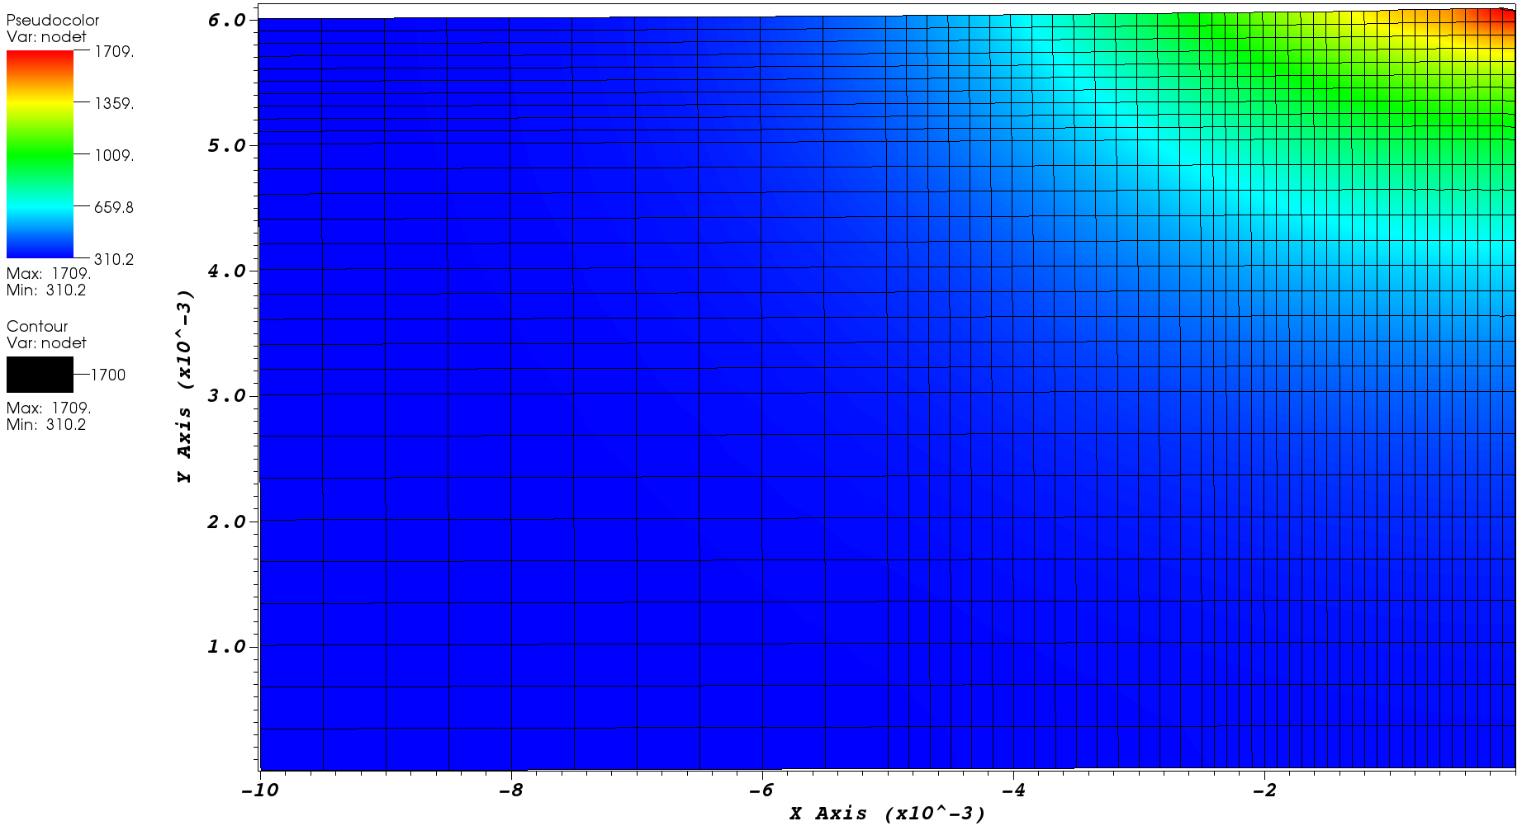
Present ALE3D Simulations
Power: 22.5 W; FWHM: 50 𝜇m; p₀ = 7.94×10⁵ W/cm²; scanning speed v = 0
Absorptivity: 0.44; Extinction coefficient 𝛽: 7.53×10⁵ cm⁻¹ (bulk)
t = 30 𝜇s
Start to melt: Reaching 1700 K
10⁻³ cm = 10 𝜇m

Slide 11
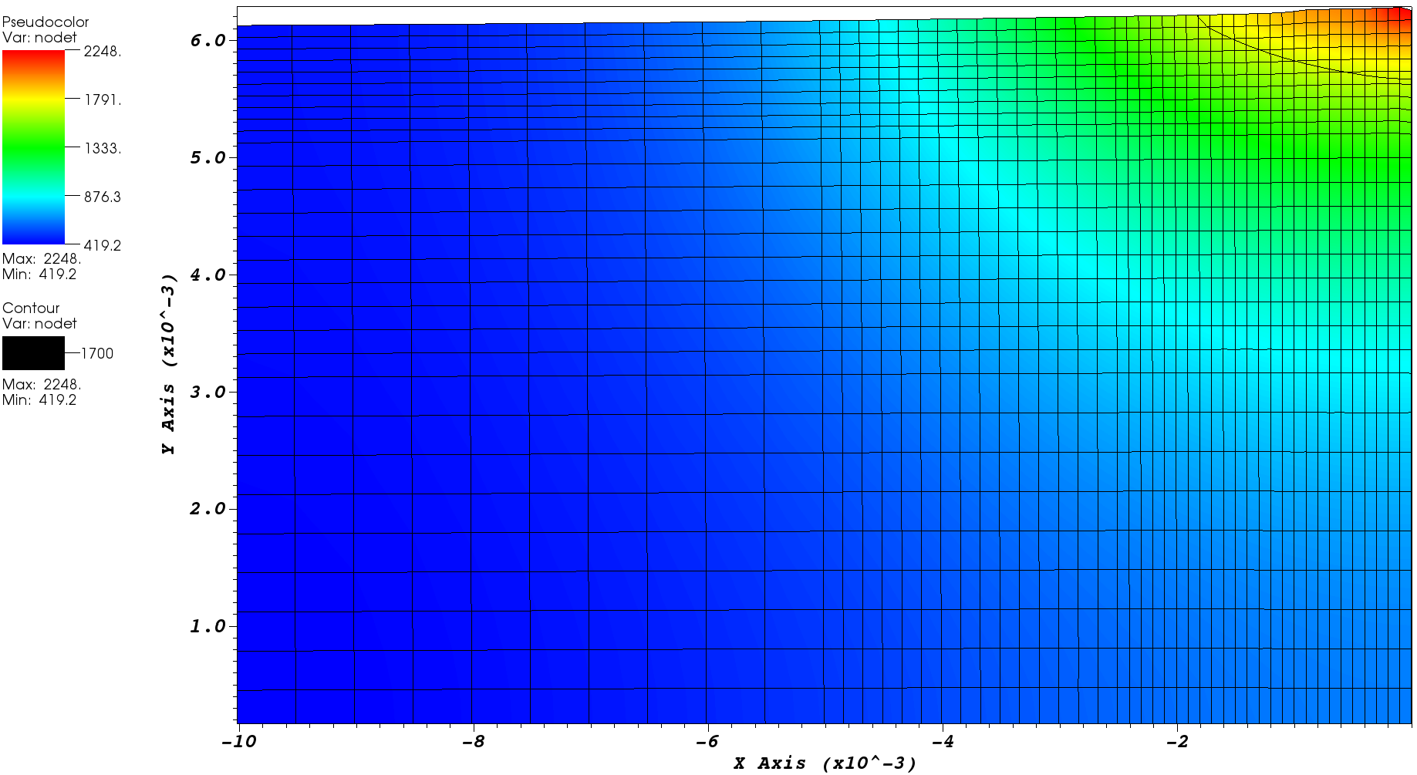
Present ALE3D Simulations
Power: 22.5 W; FWHM: 50 𝜇m; p₀ = 7.94×10⁵ W/cm²; scanning speed v = 0
Absorptivity: 0.44; Extinction coefficient 𝛽: 7.53×10⁵ cm⁻¹ (bulk)
t = 170 𝜇s
melt width: 36 𝜇m
melt depth: 4.5 𝜇m
width:depth = 8:1

Slide 12
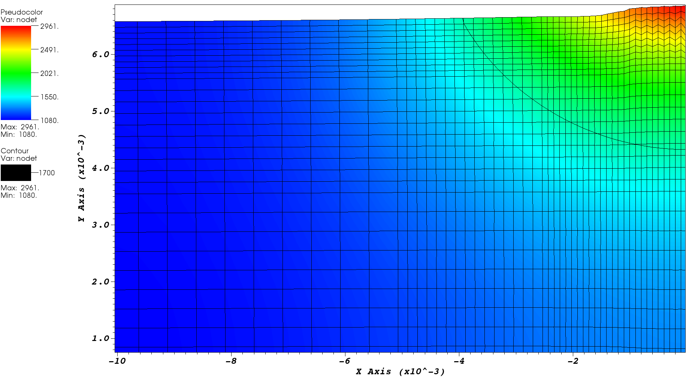
Present ALE3D Simulations
Power: 22.5 W; FWHM: 50 𝜇m; p₀ = 7.94×10⁵ W/cm²; scanning speed v = 0
Absorptivity: 0.44; Extinction coefficient 𝛽: 7.53×10⁵ cm⁻¹ (bulk)
t = 670 𝜇s
melt width: 79 𝜇m
melt depth: 23 𝜇m
width:depth = 3.4:1

Slide 13
Present ALE3D Simulations
Power: 22.5 W; FWHM: 50 𝜇m; p₀ = 7.94×10⁵ W/cm²; scanning speed v = 0
Absorptivity: 0.44; Extinction coefficient 𝛽: 7.53×10⁵ cm⁻¹ (bulk)

Slide 14
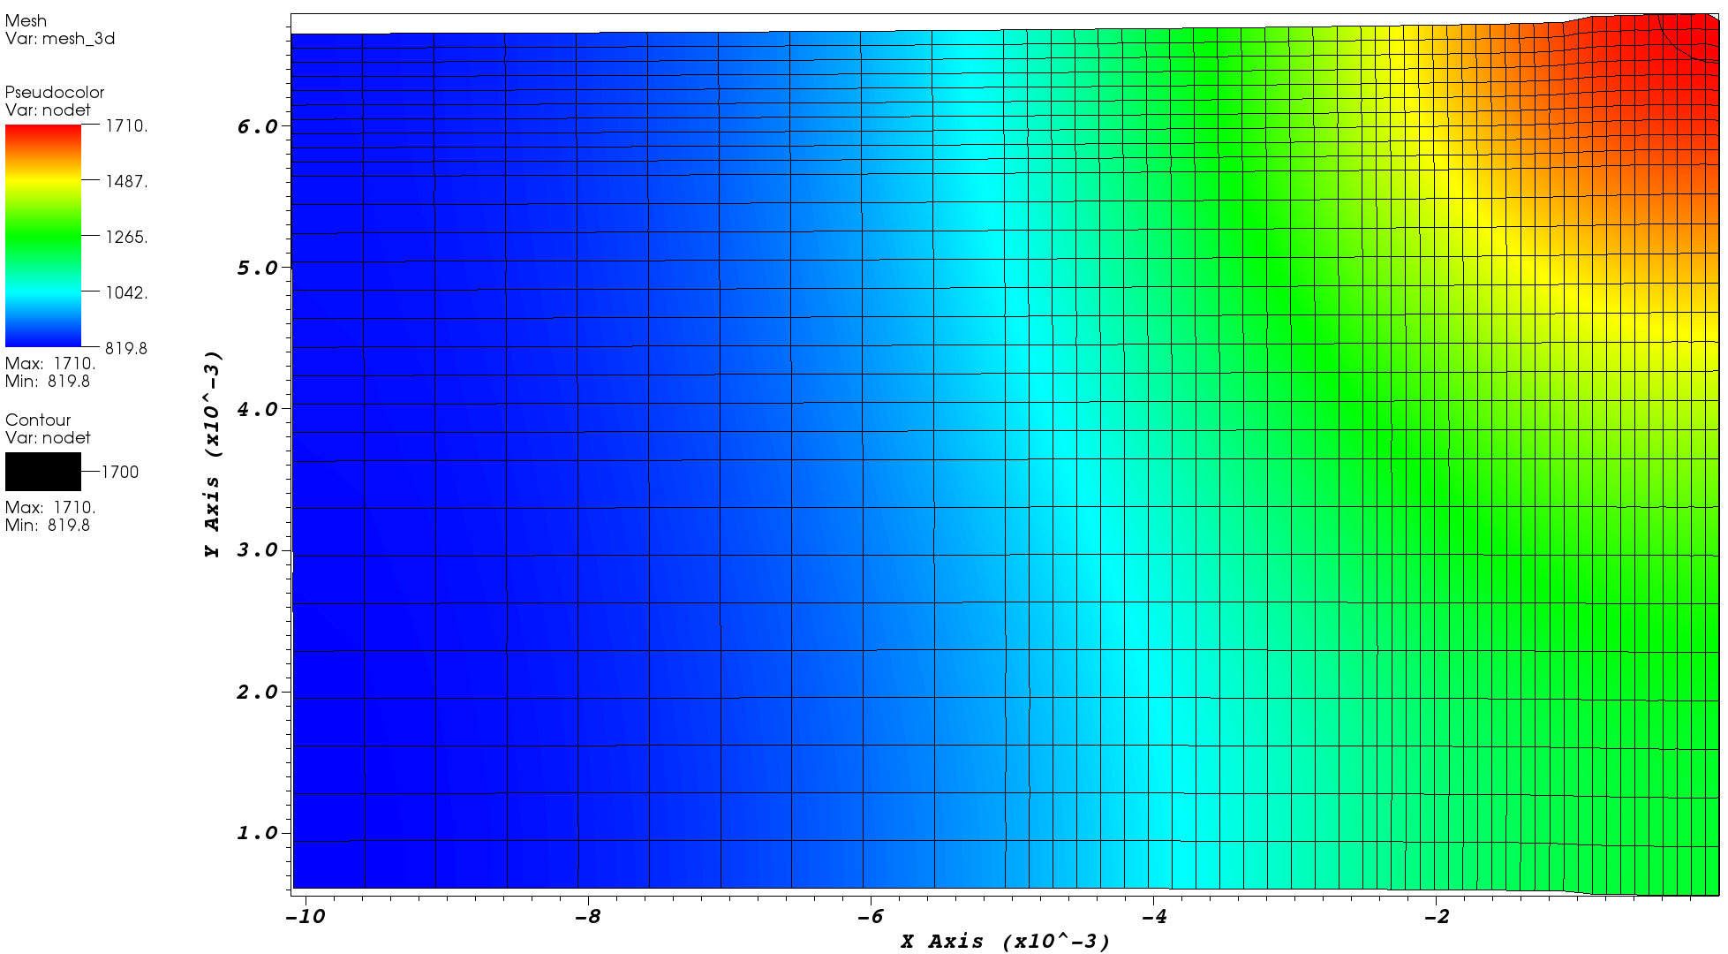
Present ALE3D Simulations
Power: 22.5 W; FWHM: 50 𝜇m; p₀ = 7.94×10⁵ W/cm²; v = 0
Absorptivity: 0.44; Extinction coefficient 𝛽: 500 cm⁻¹ (powder, d = 57 𝜇m)
t = 470 𝜇s
Start to melt
10⁻³ cm = 10 𝜇m

Slide 15
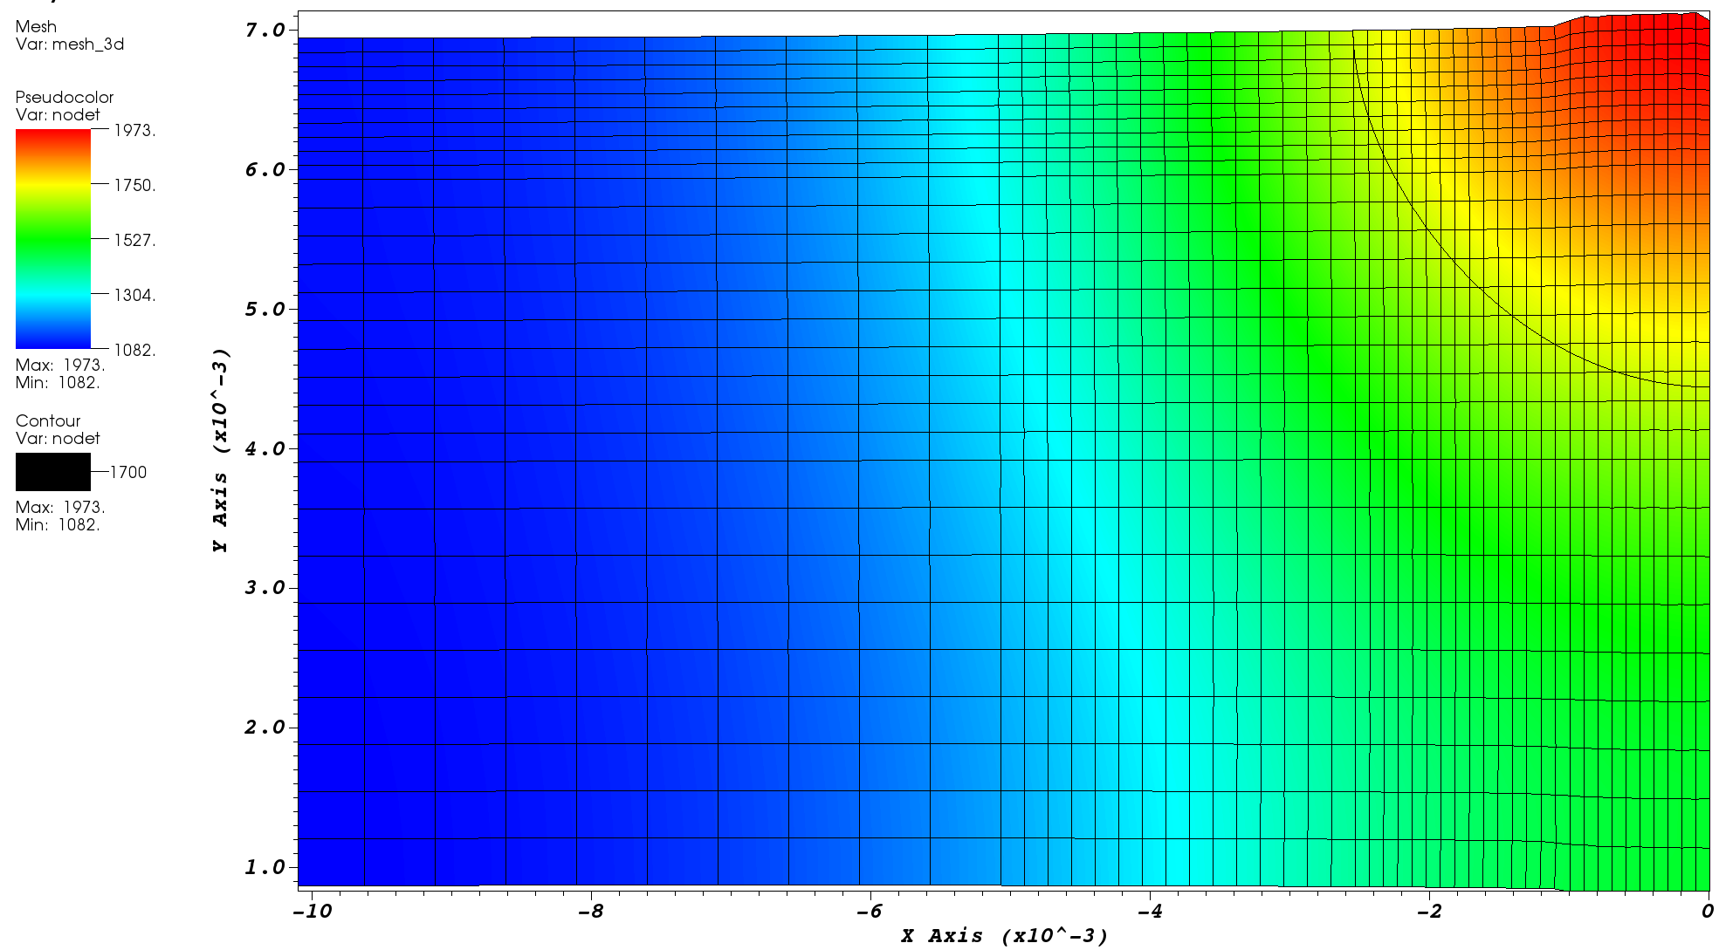
Present ALE3D Simulations
Power: 22.5 W; FWHM: 50 𝜇m; p₀ = 7.94×10⁵ W/cm²; v = 0
Absorptivity: 0.44; Extinction coefficient 𝛽: 500 cm⁻¹ (powder, d = 57 𝜇m)
t = 670 𝜇s
melt width: 50 𝜇m
melt depth: 25 𝜇m
width:depth = 2:1

Slide 16
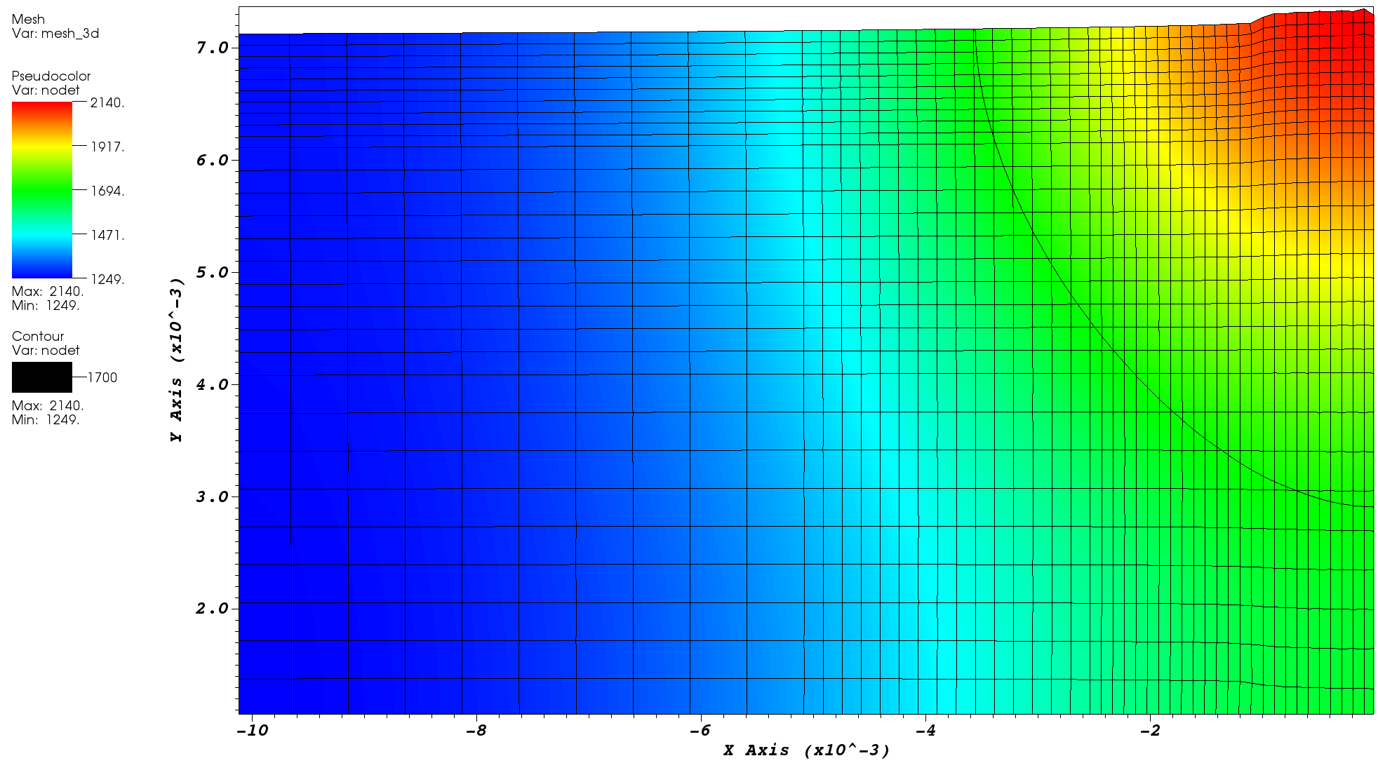
Present ALE3D Simulations
Power: 22.5 W; FWHM: 50 𝜇m; p₀ = 7.94×10⁵ W/cm²; v = 0
Absorptivity: 0.44; Extinction coefficient 𝛽: 500 cm⁻¹ (powder, d = 57 𝜇m)
t = 800 𝜇s
melt width: 72 𝜇m
melt depth: 42 𝜇m
width:depth = 1.7:1

Slide 17
Present ALE3D Simulations
Power: 22.5 W; FWHM: 50 𝜇m; p₀ = 7.94×10⁵ W/cm²; v = 0
Absorptivity: 0.44; Extinction coefficient 𝛽 are different
7.53×10⁵ cm⁻¹ (bulk)
500 cm⁻¹ (powder, d = 57 𝜇m)
t = 780 𝜇s
width/depth = 3/1
t = 670 𝜇s
width/depth = 2/1

Slide 18
Present ALE3D Simulations
Power: 22.5 W; FWHM: 50 𝜇m; p₀ = 7.94×10⁵ W/cm²; v = 0
Absorptivity: 0.44; Extinction coefficient 𝛽 are different
Melt width and depth
Width-to-depth ratio

Slide 19
Present ALE3D Simulations
v = 0; absorptivity: 0.44; 𝛽: 7.53×10⁵ cm⁻¹
P = 22.5 W, FWHM = 50 𝜇m
p₀ = 7.94×10⁵ W/cm²
P = 45 W, FWHM = 60 𝜇m
p₀ = 11.03×10⁵ W/cm²
t = 780 𝜇s
width/depth = 3/1
t = 200 𝜇s, width/depth = 4/1

Slide 20
Present ALE3D Simulations
Power: 22.5 W; FWHM: 50 𝜇m; p₀ = 7.94×10⁵ W/cm²; v = 0
Extinction coefficient 𝛽: 7.53×10⁵ cm⁻¹ (bulk)
Absorptivity: 0.44
Absorptivity: 0.30
t = 780 𝜇s
width/depth = 3/1
t = 150 𝜇s, starts to melt
t = 800 𝜇s, width/depth = 5/1

Slide 21
Laser Scanning
q₀ is the maximum incident energy per unit area (J/cm²)
For on-spot laser (v = 0)
P = 22.5 W, FWHM = 50 𝜇m, v = 15 cm/s, q₀ = 282 J/cm²
P = 45.0 W, FWHM = 60 𝜇m, v = 30 cm/s, q₀ = 235 J/cm²
Assuming laser is circular:

Slide 22
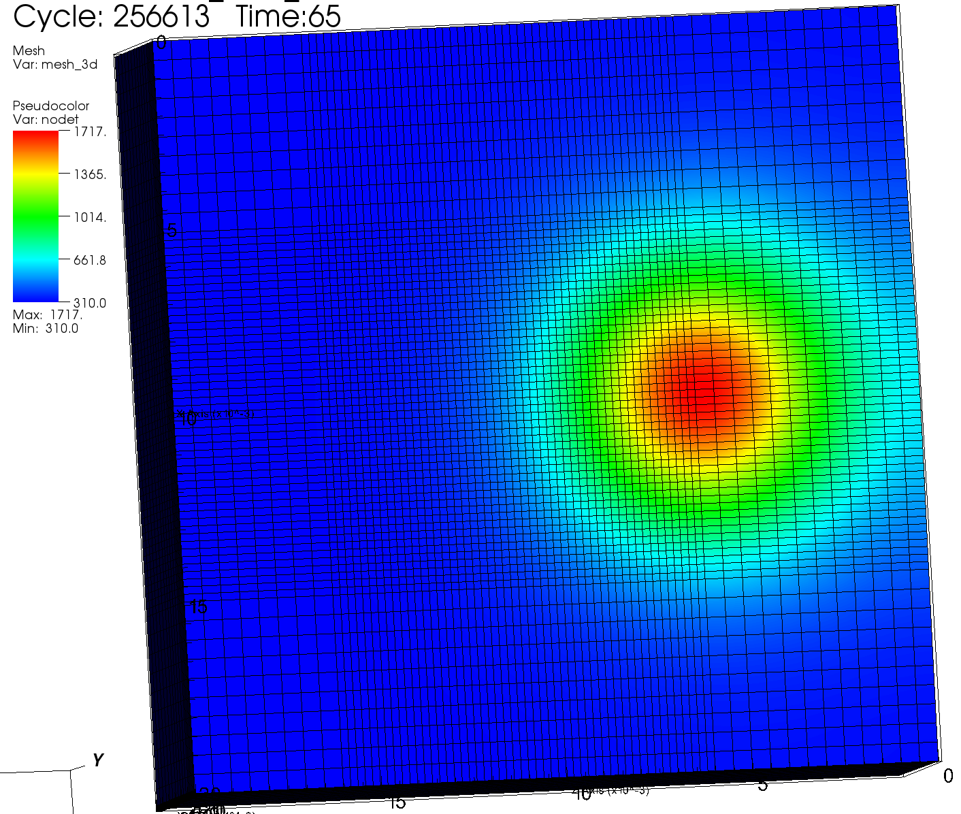
Present ALE3D Simulations
3D simulations for scanning laser
Scanning speed v = 15 cm/s
P = 22.5 W; FWHM = 50 𝜇m
q₀ = 282 J/cm²
𝜏 = FWHM/v = 333 𝜇s
Absorptivity: 0.44
𝛽 = 7.53×10⁵ cm⁻¹
t = 65 𝜇s, start to melt v = 15 cm/s
t = 30 𝜇s, start to melt v = 0

Slide 23
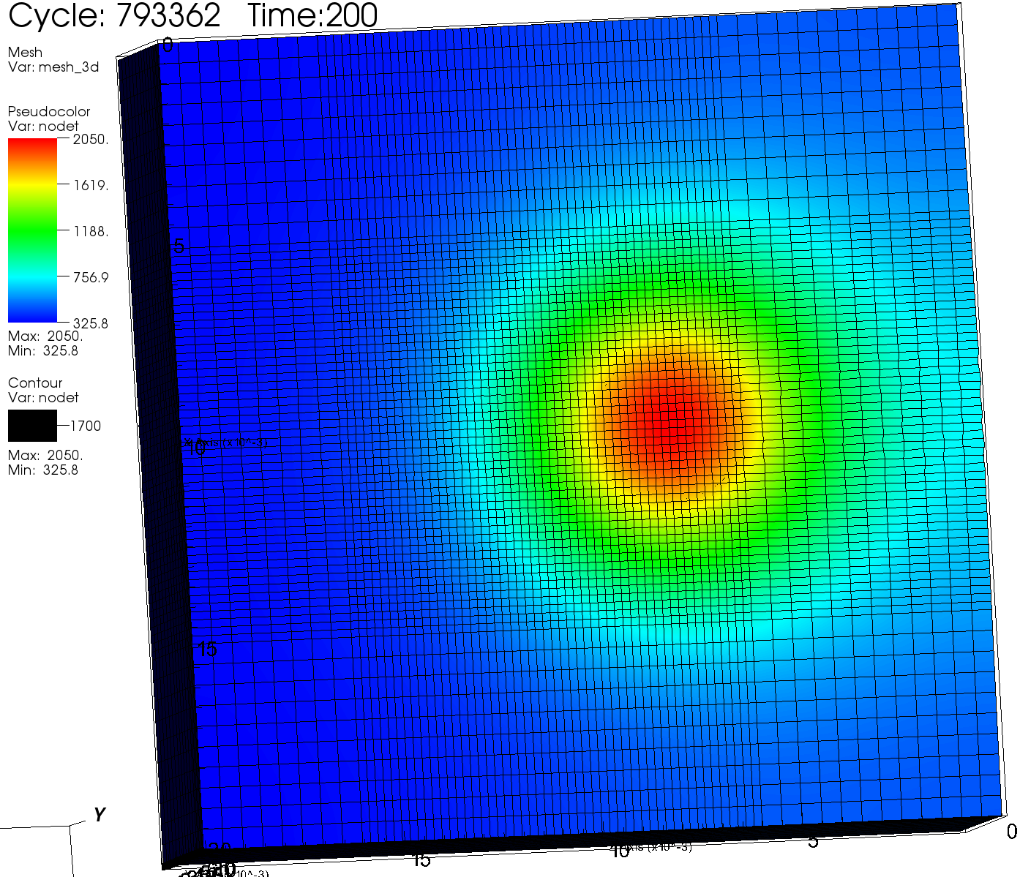
Present ALE3D Simulations
3D simulations for scanning laser
Scanning speed v = 15 cm/s
P = 22.5 W; FWHM = 50 𝜇m
q₀ = 282 J/cm²
𝜏 = FWHM/v = 333 𝜇s
Absorptivity: 0.44
𝛽 = 7.53×10⁵ cm⁻¹
t = 200 𝜇s, v = 15 cm/s
width = 31 𝜇m, depth = 4.5 𝜇m
t = 200 𝜇s, v = 0
width = 39 𝜇m, depth = 5 𝜇m

Slide 24
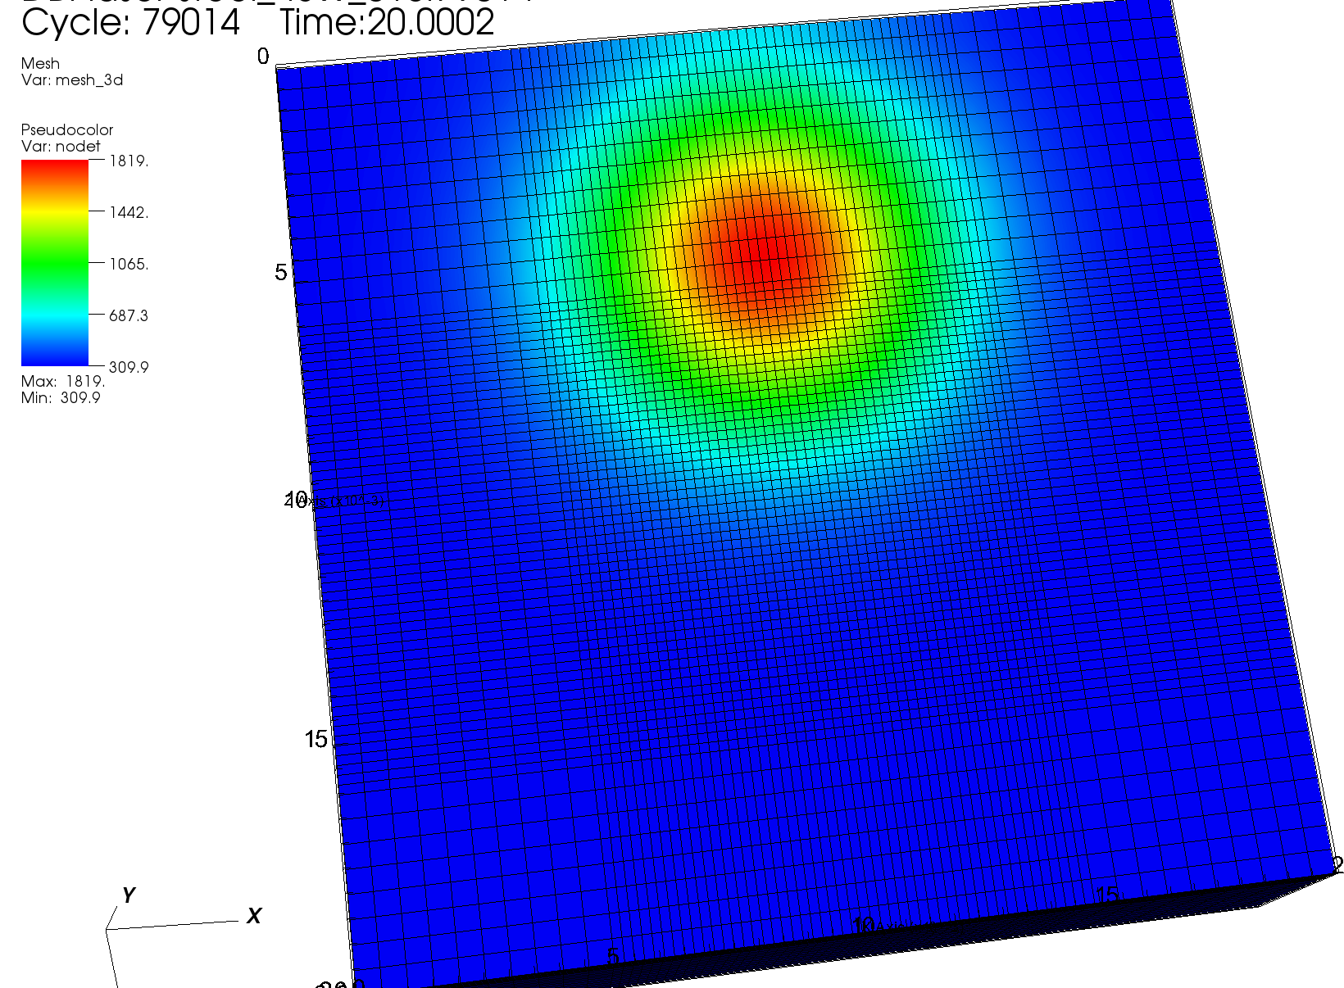
Present ALE3D Simulations
3D simulations for scanning laser
Scanning speed v = 30 cm/s
P = 45 W; FWHM = 60 𝜇m
q₀ = 235 J/cm²
𝜏 = FWHM/v = 200 𝜇s
Absorptivity: 0.44
𝛽 = 7.53×10⁵ cm⁻¹
t = 18 𝜇s, start to melt v = 30 cm/s
t = 17 𝜇s, start to melt v = 0

Slide 25
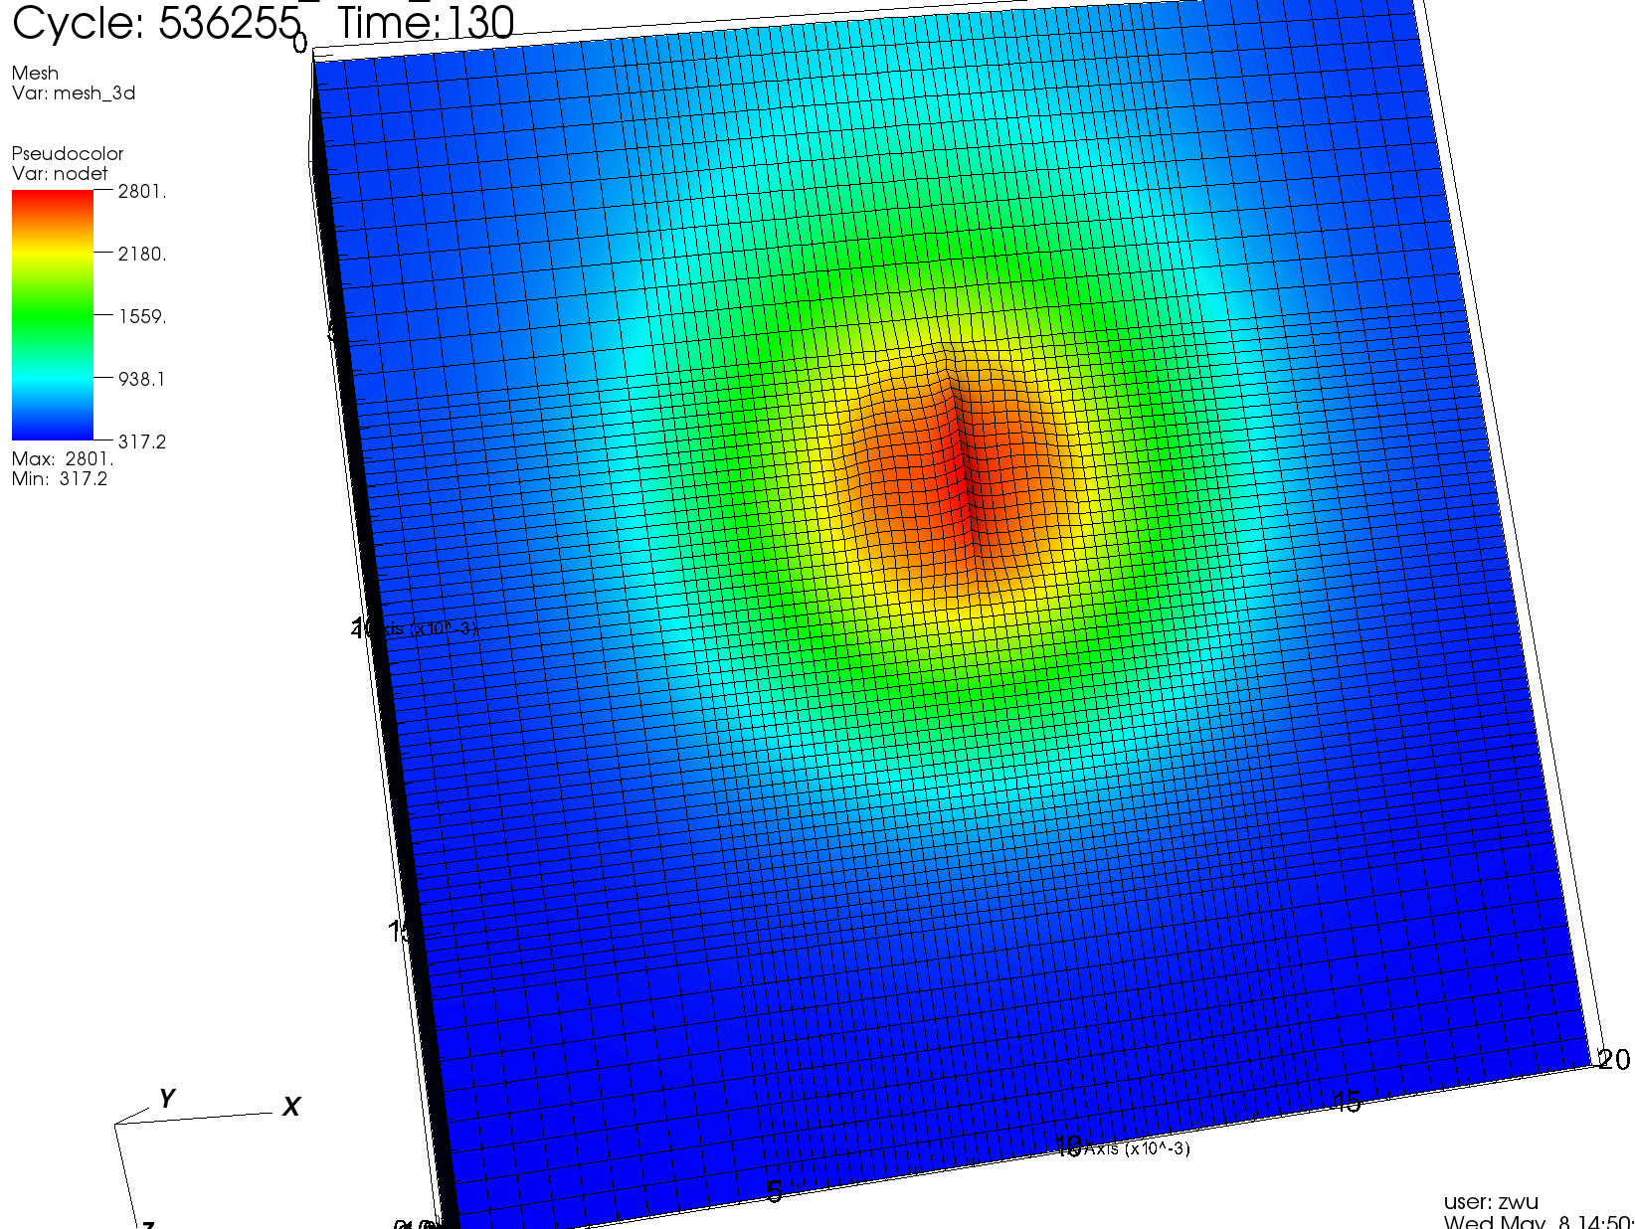
Present ALE3D Simulations
3D simulations for scanning laser
Scanning speed v = 30 cm/s
P = 45 W; FWHM = 60 𝜇m
q₀ = 235 J/cm²
𝜏 = FWHM/v = 200 𝜇s
Absorptivity: 0.44
𝛽 = 7.53×10⁵ cm⁻¹
t = 130 𝜇s, v = 30 cm/s
width = 67 𝜇m, depth = 12 𝜇m
t = 130 𝜇s, v = 0
width = 72 𝜇m, depth = 13 𝜇m

Slide 26
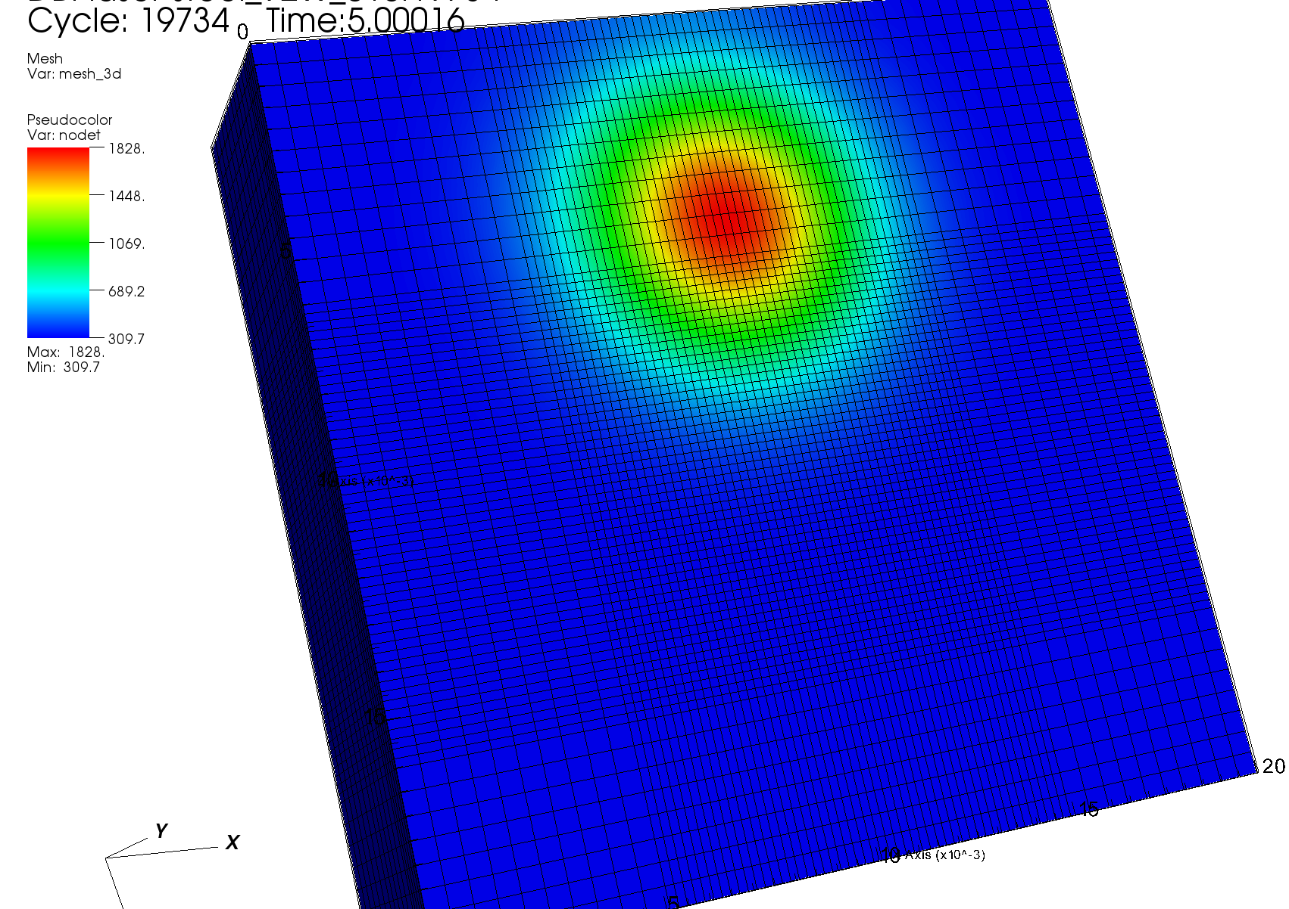
Present ALE3D Simulations
3D simulations for scanning laser
Scanning speed v = 38 cm/s
P = 92 W; FWHM = 54 𝜇m
q₀ = 396 J/cm²
𝜏 = FWHM/v = 142 𝜇s
Absorptivity: 0.44
𝛽 = 7.53×10⁵ cm⁻¹
t = 4 𝜇s, start to melt

Slide 27
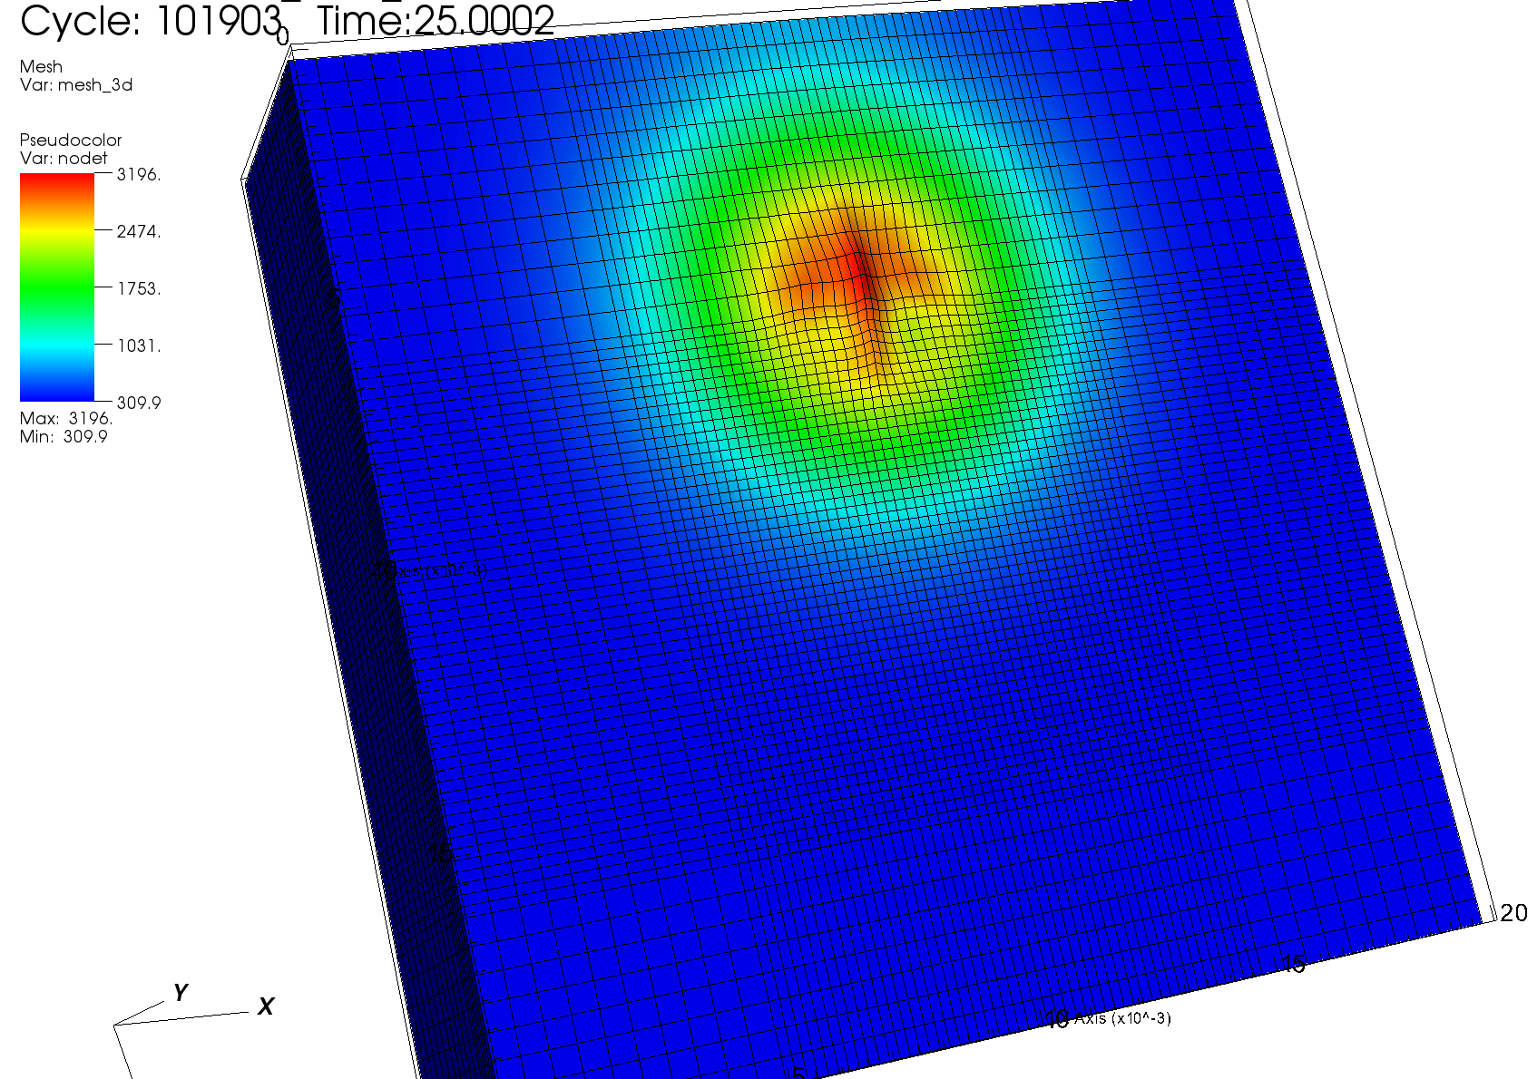
Present ALE3D Simulations
3D simulations for scanning laser
Scanning speed v = 38 cm/s
P = 92 W; FWHM = 54 𝜇m
q₀ = 396 J/cm²
𝜏 = FWHM/v = 142 𝜇s
Absorptivity: 0.44
𝛽 = 7.53×10⁵ cm⁻¹
t = 25 𝜇s, reaches the boiling point!

Slide 28
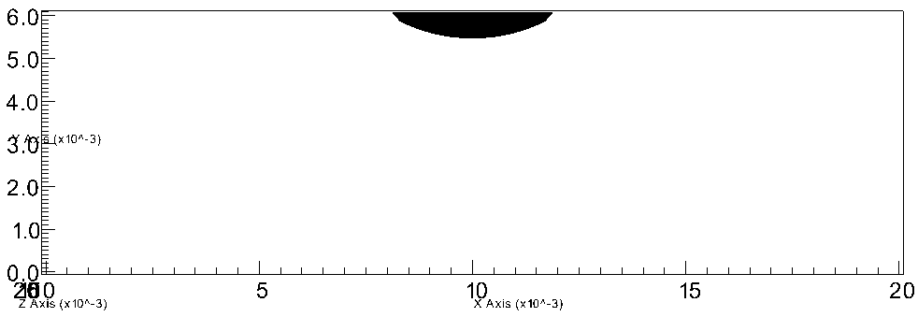
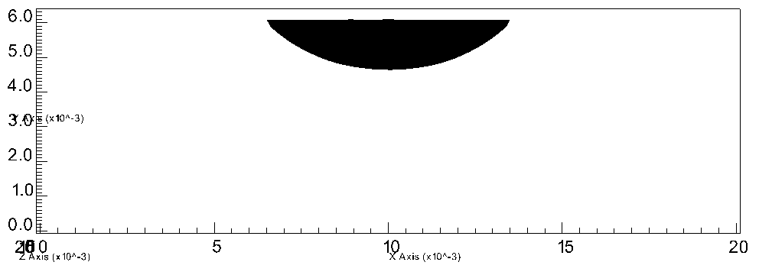
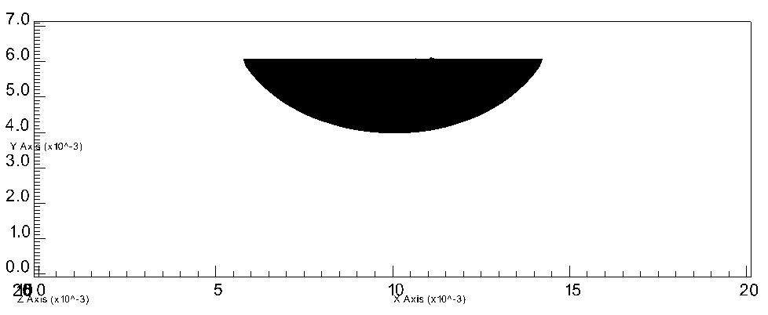
Melting of Stainless Steel
P = 22.5 W, FWHM = 50 𝜇m
Absorptivity = 0.44
t = 200 𝜇s
P = 45 W, FWHM = 60 𝜇m
Absorptivity = 0.44
t = 130 𝜇s
P = 92 W, FWHM = 54 𝜇m
Absorptivity = 0.33
t = 25 𝜇s

Slide 29
Conclusions and Future Work
We have simulated laser heating and melting bulk stainless steel.
In 2D simulations, we investigated the relations between melt hole size and model parameters, including optical properties of steel and powder distribution of laser, for zero scanning speed.
In 3D simulations, we studied melting processes using three laser beams with different power, size, and scanning speed.
In the future we’ll study
electron beam heating and melting metals
electron beam processing metallic powder materials

